Slide 1
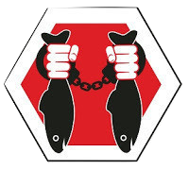
Challenge 10:
Passive IUU Detection Device
PoachStopper
Stopping illegal fishing in protected environments
“The ideal surveillance system would be easy to deploy and maintain, and provide accurate and autonomous detection performance, with minimal operator interaction.”
- Sorensen 2010
Notes:
Protecting restricted fishing zones (e.g. marine reserves, remote areas) from illegal fishing is a huge challenge. A passive tool (maybe using sonar?) that helps identify fishing activity in restricted areas would help agencies monitor, track, and enforce laws more effectively.

Slide 2
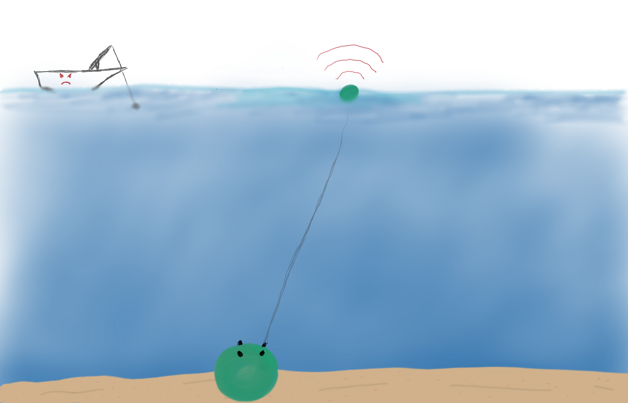
Satellite transmitter
Poacher
Passive microphone sensor

Slide 3
Software Demo
Monitor, Track, and Enforce
Notes:
Deep Learning Algorithms
Detect Fishing Activity
Apply a “signature” to a specific boat
Simulated Iridium Satellite Transmission
(Actually an HTTP API Call)
Enforcement UI

Slide 4
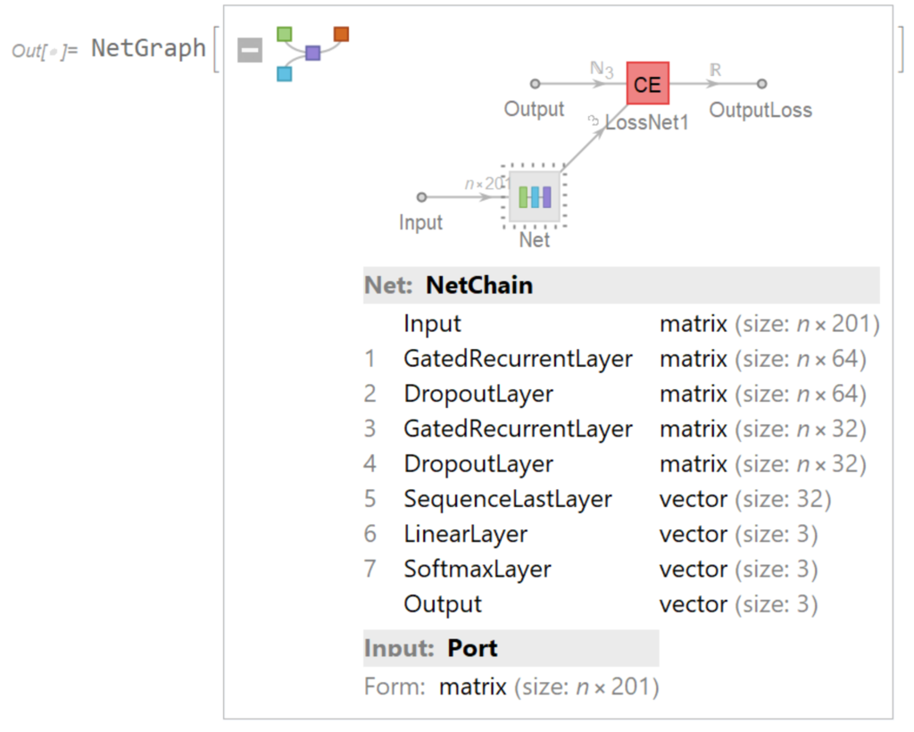
What did you just see?
Notes:
Deep Learning Algorithms
Detect Fishing Activity
Apply a “signature” to a specific boat
Simulated Iridium Satellite Transmission
(Actually an HTTP API Call)
Enforcement UI

Slide 5
What. About. Hardware?
Don’t worry, we have a design!
Notes:
With a subsurface listening device, invisible to poacher, that, upon IUU detection releases an alarm buoy that calls the authorities via Iridium
Alternatively, use OpenROV
Options we Ruled Out
Anchored Open-Air Buoy
Too vulnerable to tampering by bad actors
Rope or chain a risk for marine animal entanglement
Single-Purpose Extended Mission Drone
Cost prohibitive as it exceeds the current cost of patrol ($1000/day)
OR, piggy-back on somebody else’s mission ;)

Slide 6
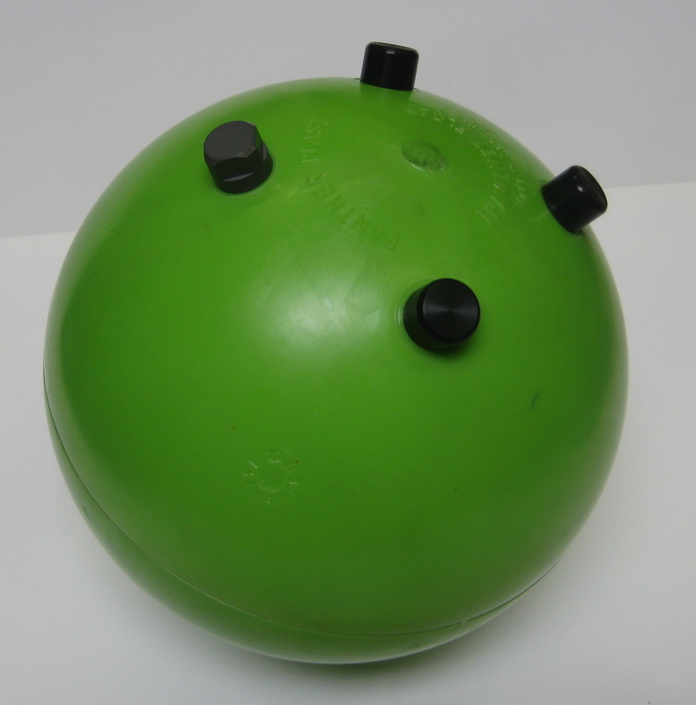
Ocean Innovation’s Instrumentation and Floatation Sphere
A 10 inch spherical enclosure, rated up to 2000m with four connector ports.

Slide 7
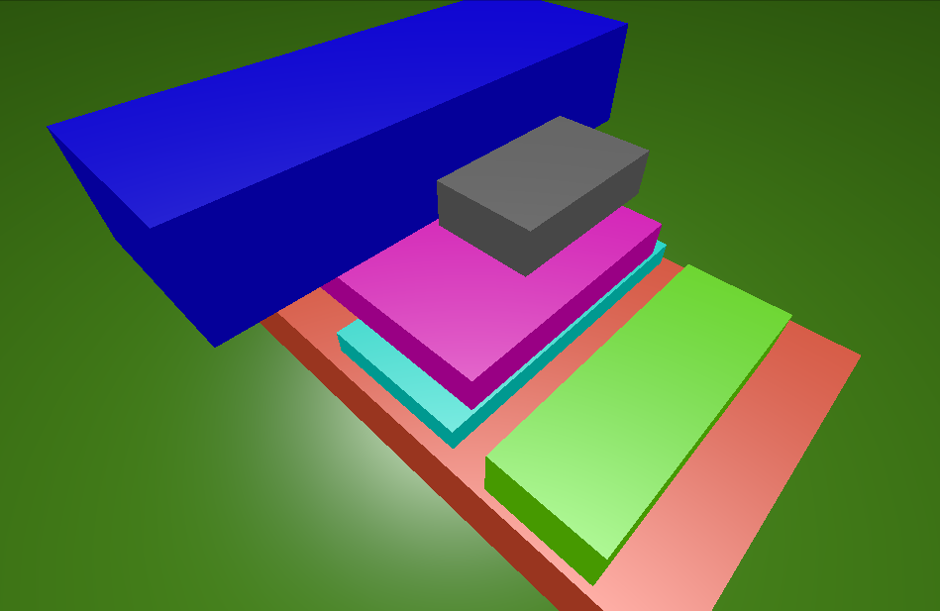
Inside the Sphere
(All Accurate Dimensions)
IRig Hydrophone Preamp
IRig Hydrophone Preamp
Raspberry Pi GPS Hat
USB Storage
Raspberry Pi Zero
Battery Pack

Slide 8
Success Metrics
 | Current Solution | Our Solution
Cost ($USD) | $1000 per day patrol boat | $11 / day ($4000 per year)
Time Investment | Daily Expeditions | Yearly Deployments
Fishing Activity Detection | Operator seeing a net | 50 km range audio detection, 98.68% accuracy
Boat Signaturing | Line of sight on the boat hull name | Unique audio fingerprint for each vessel
Coverage Area | Operator’s line of sight | 100 devices for 12000km²

Slide 9
Thank you!
Thank you Carlos and Plug!
Thank you Alex and Erin!
Thank you Joe and Greg from Exocetus!
Thank you Kicking Horse, Clover, AREAFOUR, and Masala!
Thank you other local sponsors!
Thank you global sponsors!

Slide 10
Success Metrics
 | Current Solution | Our Solution
Cost ($USD) | $1000 per day patrol boat | $11 / day ($4000 per year)
Time Investment | Daily Expeditions | Yearly Deployments
Fishing Activity Detection | Operator seeing a net | 50 km range audio detection, 98.68% accuracy
Boat Signaturing | Line of sight on the boat hull name | Unique audio fingerprint for each vessel
Coverage Area | Operator’s line of sight | 100 devices for 12000km²

Slide 11
Risks and Mitigations
Risk: Tampering by bad actors
Mitigations:
Weekly automated equipment checks
Manual retrieval via surface ping and inflatable bag
Risk: Battery drain will render the device useless
Mitigations:
Continuous improvement of onboard hardware design and firmware
“Mostly sleeping” device - only wake up to collect data
Notes:
??Cut out for time saving??

Slide 12
Next Steps
Refine UI
Refine API + Iridium Integration
Improve Deep Learning Algorithms
  Better fishing activity detection
  Better boat identification
Outfit the device with more hardware and software
  Floatation Bag?
Make the battery last longer, and longer and longer
Notes:
??Cut out for time saving??

